Slide 1
Shiny Workshop Day 1
August 27, 2019
TEA Analytics

Slide 2
Environment Settings

Slide 3
To-Do List
Check the installation of needed apps
R
Rstudio
Download zipped files and save it at Desktop
https://github.com/TEA-Analytics/ShinyWorkshop/releases
Install packages
01_InstallPackages.r
Get cheatsheet.

Slide 4
Disclaimer
This workshop is designed solely with Eina’s biases and skewed personal experiences dealing with r and rshiny.
Eina does not claim the latest knowledge in r shiny, nor the current best practices.
Please know that R community has been evolving rapidly, Eina – who srated R coding before tidyverse era – is a bit old-fashioned, and this does not mean Eina is discouraging anybody from adopting the latest trend in R.

Slide 5
Shiny Basics Review

Slide 6


UI and Server
Server
UI
Give me this.
Here it is.
I know how to compute.
I know how to display.
“UI” specifies layout of the app and requests things to a server when needed.
“Server” gives requested whatever (plot, table, …).
Both UI and server are within R.

Slide 7
Server and Shiny-Server
“Server” may refer to the server section of the app.
“Shiny Server” may mean an actual web server that hosts shiny apps.
Topics of deployment will be covered tomorrow.
You have to know the context for knowing which one means.

Slide 8
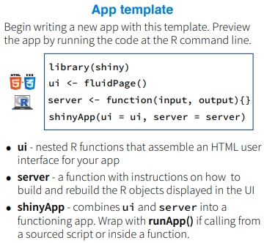
File structures
Many examples online will have everything in one script using shinyApp().
For a small app, it’s easy to see.
Our default file structure is to break it down to 3 (or more) files:
Ui.r
Server.r
Global.r (Optional)
All these 3 files needs to be in a same folder.
runApp(‘foldername’)

Slide 9
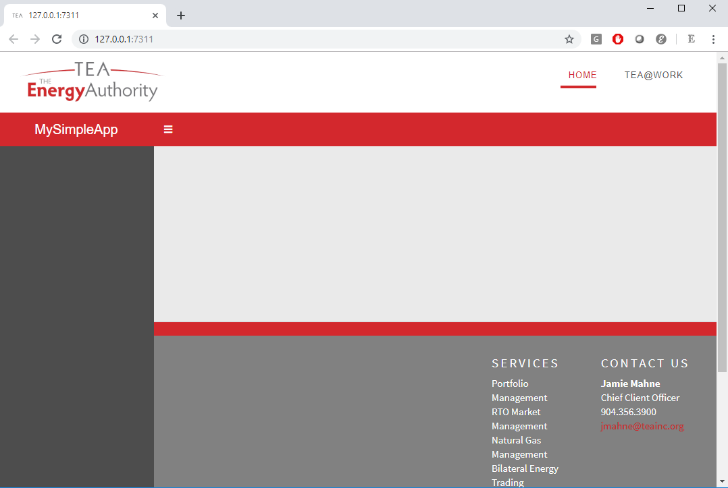
‘teadashboard’ TEA-version of ‘shinydashboard’
In general, we recommend using the ‘teadashboard.’
All functionalities are the same with shinydashboard.
Open “TheSimplest” template and run it.
The RunApp button.

Slide 10
Exercise 1
Do
Break it down to 3 files.
Create a app folder.
Ui.r, server.r, and global.r.
Add the following:
Read in data
Add a section (menuitem)
Add a variable selector
Add a time series plot.
Add a table.
Hints
Read.csv
menuItem
selectInput
plotOutput/renderPlot
DTOutput/renderDataTable

Slide 11
Exercise 3
Make the file dependent on market.
Create a selector for market in the sidebar.
Create a reactive object for data.
Make a dymanic UI.
Get rid of the error during computation.
Hints:
selectInput
Reactive
uiOutput/renderUI
Req

Slide 12
Layout
Always use boxes.
Use fluidRow and columns for dividing the page.
Within the divided section of the page, width is specified over 12.
Height specification optional.
Box (3)
Box (width = 9)
Fluid row
Box (6)
Box(4)
Box (width = 12)
Fluid row
Box(12)
Column (width = 8)
Column (column = 4)

Slide 13
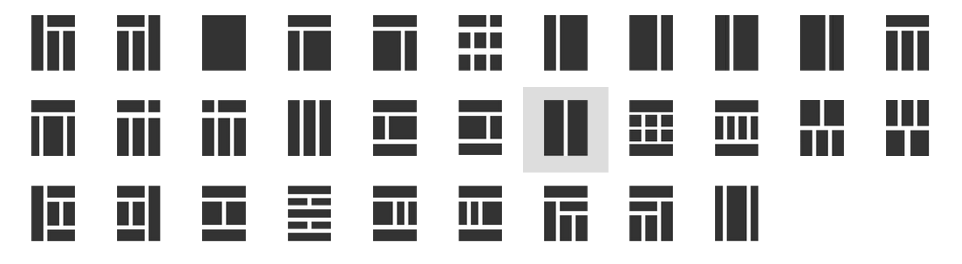
Examples
1
3
2

Slide 14

Exercise 2
Add boxes to the app.
Add anther section (menuitem) and add boxes like this:
Open the ‘TEABranded’ template and notice
A few different layouts
Sidebar submenues
User longin.
“About” page
Check out icons
https://rstudio.github.io/shinydashboard/appearance.html#icons

Slide 15
Tour of TEA Shiny Apps

Slide 16
LMP Forecast
https://analyze.teainc.org/LMP-Forecast-Main/
Notice
Progress Bar
Select Inputs with multiple choices
Interactivity with htmlwidgets
Ability to update data and rerun the model.
Interactive Maps

Slide 17
DeltaHedging
https://analyze.teainc.org/DeltaHedging/
Notice
Excel like look and feel.
Base shiny interactivity
Database connections (read/write)

Slide 18
HedgeFox
https://analyze.teainc.org/HedgeFox/CAISO/
Notice:
Notice subfolder structure
Hide elements by shinyjs.
Use of information boxes.
Rmarkdown reports.

Slide 19
Understanding Reactivity

Slide 20
Our First App

Slide 21
Objects
R objects
Data frames
arrays
Functions
List
…
Reactive Objects ← Think this like a function.
ReactiveValues ← Think this like a list.

Slide 22
Can you use reactive()?

Slide 23
Use Cases for ReactiveValues
Partial data imports.
Status flag

Slide 24
When to load data?

Slide 25
Progress bars

Slide 26
https://resources.rstudio.com/shiny-developer-conference/shinydevcon-debugging-jonathanmcpherson-1080p
Debugging

Slide 27
Brekpoints works only within server.
Browser()
conditional
Profvis

Slide 28
Database Connections

Slide 29
https://shiny.rstudio.com/gallery/widget-gallery.html
Widget Gallery

Slide 30
Tables

Slide 31
Table Choices
Datatable (DT)
Rhandsontable
Formattable
https://renkun-ken.github.io/formattable/

Slide 32
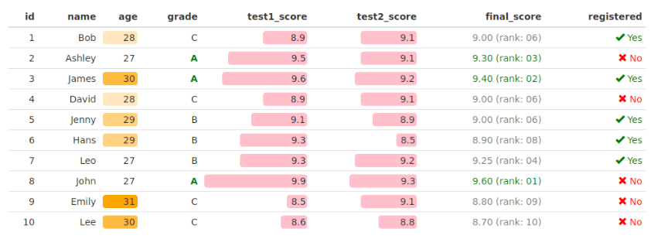
Formattable

Slide 33
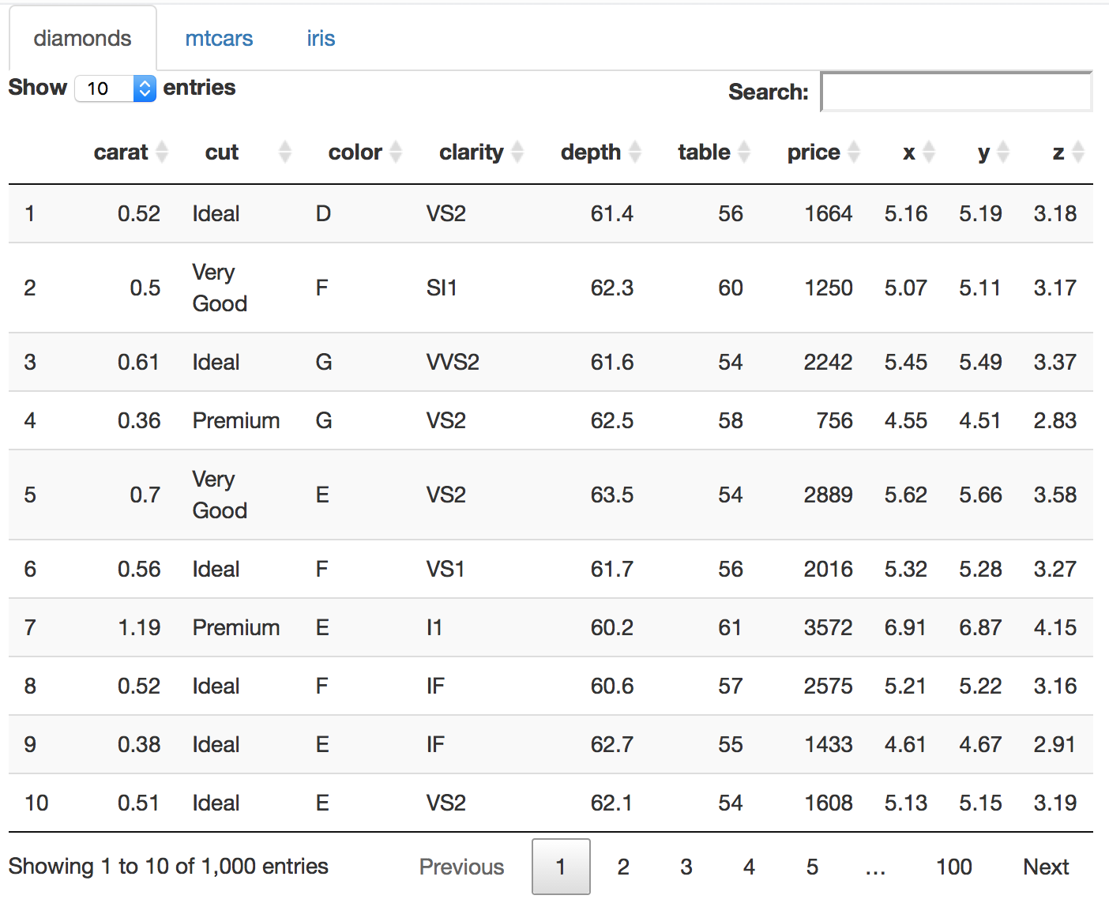
DataTables

Slide 34

Log in info.

Slide 35
Conversation on external (client facing) vs internal.

Slide 36
Git/github

Slide 37
Deployment
Access
Timeout
Default
Making it accessible for external client
Technically how
Concerns/disclaimer.

